Slide 1





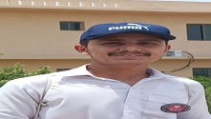

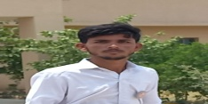

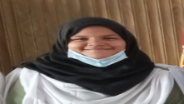

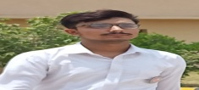
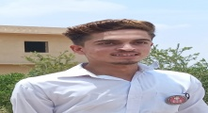
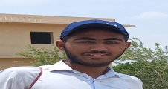






FC PUBLIC SCHOOL & COLLEGE,
Kohlu- Balochistan
Name: Adnan Khan
F. Name: Badsha Hussain
Class: X
Marks obtained: 1100/1065
Percentage: 96.82 %
Federal board of intermediate education Islamabad

Slide 2

FC PUBLIC SCHOOL & COLLEGE,
Sibi-Balochistan
Name: Rafia Bibi
F. Name: Abdul Sattar
Class: X
Marks obtained: 1100/1007
Percentage: 91.54 %
Federal board of intermediate education Islamabad

